Slide 1



Electricity Demand and Price Forecasting
An Infosys Springboard Internship Project -
To explore the use of machine learning to predict electricity demand and price, supporting smart grid operations and
data-driven decision-making.
By Gauri Phatate
Date : 19 July, 2024

Slide 2

Project Statement
Accurate Energy Forecasting
Increasing need for accurate energy forecasting to
optimize grid
operations.
Machine Learning Utilization
Utilize machine
learning to predict electricity demand
and prices.
Diverse Data
Integration
Incorporate diverse
data sources like
historical demand,
weather variables,
and other factors.
4
Smart Grid Support
Support smart grid operations and facilitate data-driven decision-making.
1
2
3

Slide 3
Project Objectives
Improved Demand Forecasting:
- Enhance resource allocation and prevent outages through accurate electricity demand forecasting.
Enhanced Price Prediction:
- Support informed decision-making in the energy market by predicting electricity prices.
Data-Driven Insights:
- Provide valuable insights to aid in long-term energy planning and smart grid operations.

Slide 4
Modules to be Implemented
Data Introduction
Exploratory Data Analysis (EDA)
- Data Preprocessing
- Feature Engineering
- Visualization with Insights
Feature Selection using RFE Method
Machine Learning Models Implementation
Model Comparison and Selection
Feature Importance
Conclusion

Slide 5

Data Introduction
Energy Dataset:
Contents: Date, price, load, generation of various energy sources (fossil fuels, renewable energy, etc.).
Rows: 35,065
Columns: 27 (with 6 all-zero, 2 with missing values)
Details: Hourly electricity generation in MW and consumption in MWh.
Weather Dataset:
Contents: Pressure, humidity, temperature, snow, rain, etc.
Rows: 178,396
Columns: 17
Details: Hourly weather data for 5 major cities in Spain.
Granularity:
Hourly data for both datasets from 31st Dec 2014 to 31st Dec 2018.

Slide 6
Exploratory Data Analysis (EDA) - 1. Data Preprocessing Summary
Data Preparation
Removed City Column: Simplified dataset by removing irrelevant information.
Grouped Weather Data: Aggregated to hourly level for easier analysis.
Ensured Correct Data Types: Converted categorical columns to strings for proper handling.
Converted Datetime Columns: Standardized datetime formats for accurate merging.
Merging Datasets
Merged Datasets: Combined energy and aggregated weather data using left join for comprehensive analysis.
Dropped Redundant Columns: Streamlined dataset by removing unnecessary columns.
Handling Missing Values: Dropped columns with all zero or null values and imputed missing values using forward fill and backward fill.

Slide 7
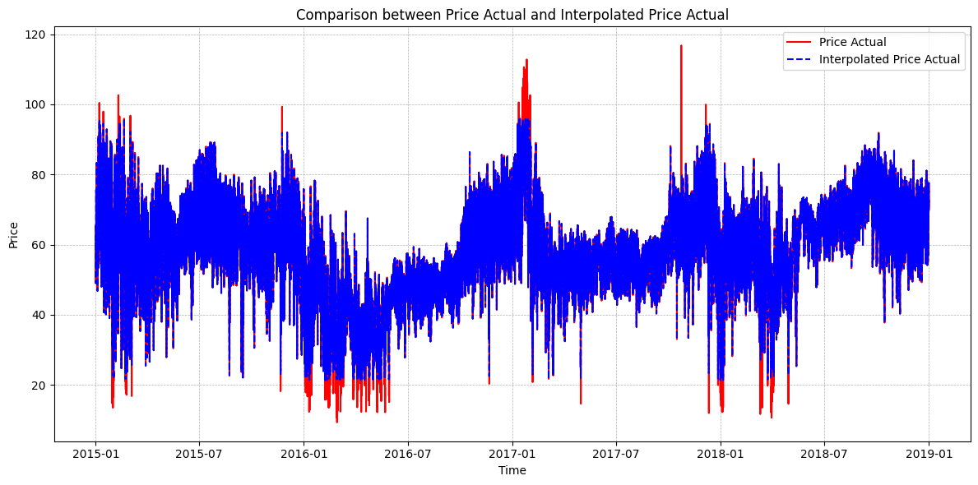
Exploratory Data Analysis (EDA) - 1. Data Preprocessing Summary Contd…
Outlier Detection
Method Used: Interquartile Range (IQR)
Quartiles used: Q1, Q3, and IQR (Q3 - Q1)
Defined bounds:
Lower bound: Q1 - 1.5 * IQR
Upper bound: Q3 + 1.5 * IQR
Outliers Identified: 699 outliers found in the 'price actual' column.
Outlier Handling: Used interpolation to replace NaN values.
Final Outcome
Merged Data Shape: (35064, 36)
Enhanced dataset with features capturing temporal patterns, peak/off-peak hours, price trends and monthly variations.

Slide 8
2. Feature Engineering Summary
is_weekday: Identified the day of the week and added a column marking weekdays (1) and weekends (0).
Peak/Off-Peak: Retrieved the hour from the 'time' column and added a column distinguishing peak (1) and off-peak (0) hours for load and price.
Month Columns: Generated individual columns for each month.
Additional Date Features:
Transformed the 'time' column into datetime format (%Y/%m/%d %H:%M:%S), managing errors with errors='coerce’.
Extracted month, day, weekday name, and weekend indicators from the 'time' column.
Final Outcome:
Shape: (35064, 59)
Dataset enriched with time-based features
Enhanced model's ability to predict electricity demand and prices

Slide 9
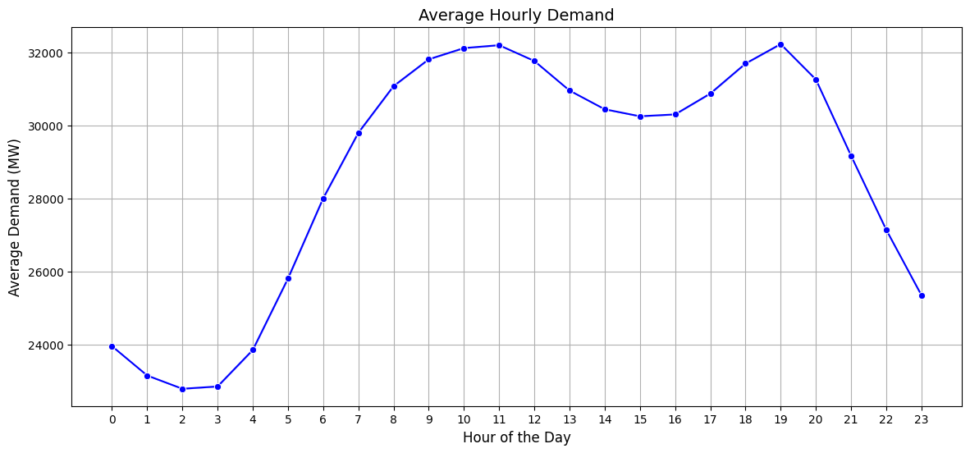
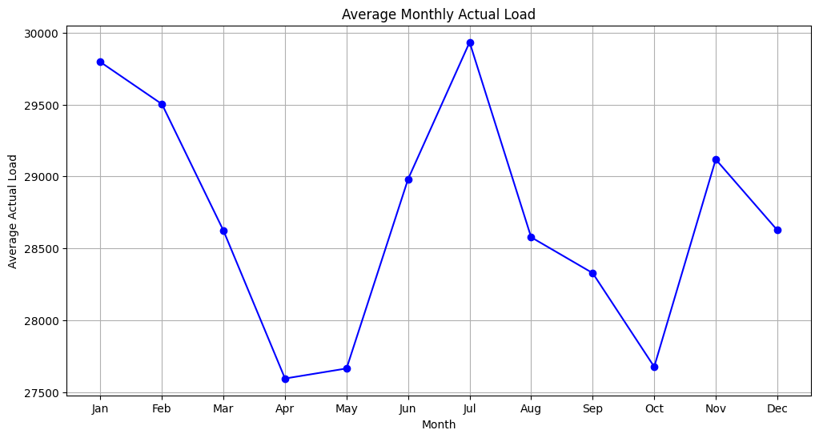
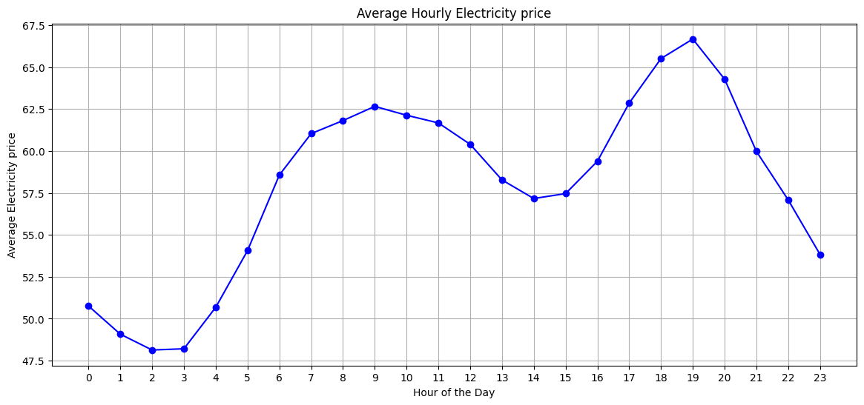
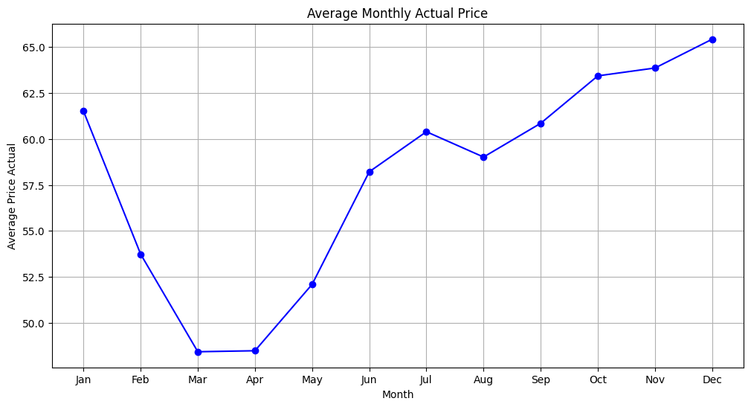
3. Visualization with Insights
Average Hourly Demand & Price Analysis
Average Monthly Actual Load & Price Analysis

Slide 10
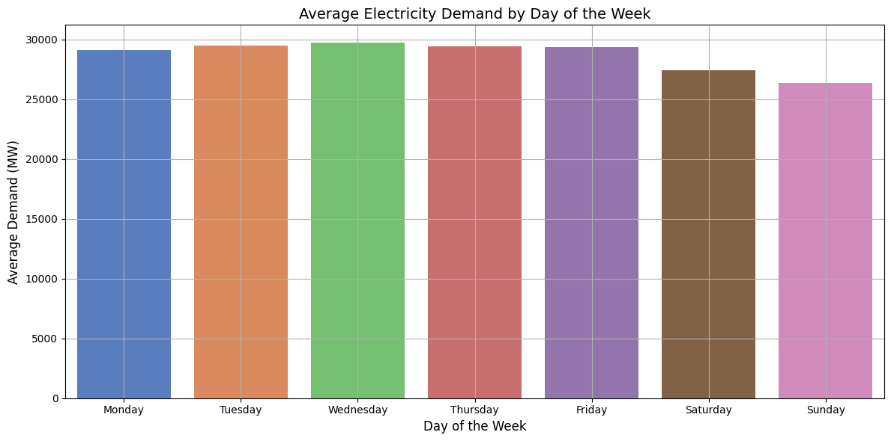
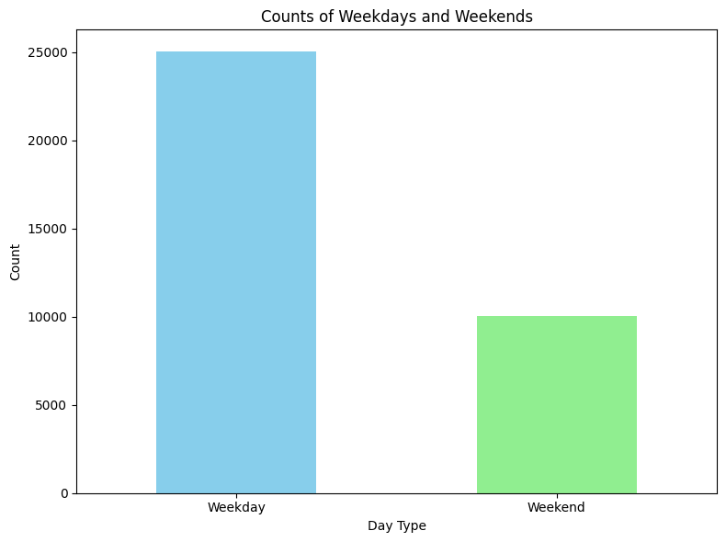
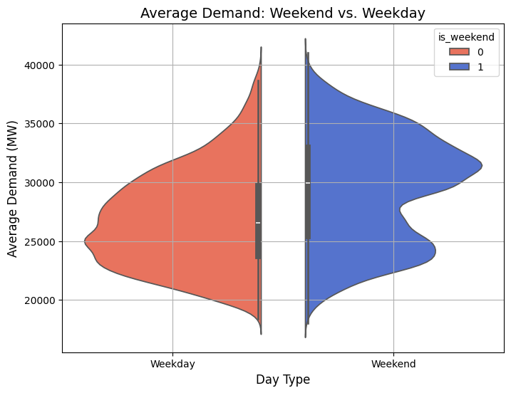
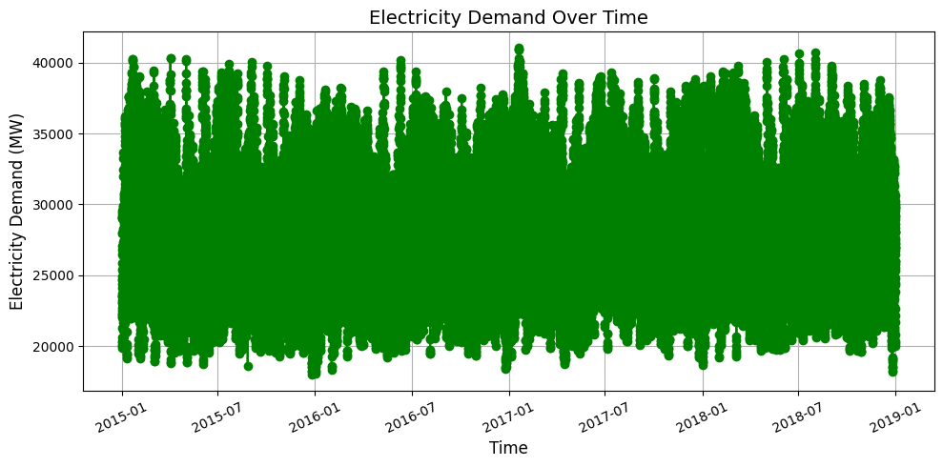
3. Visualization with Insights Contd…

Slide 11
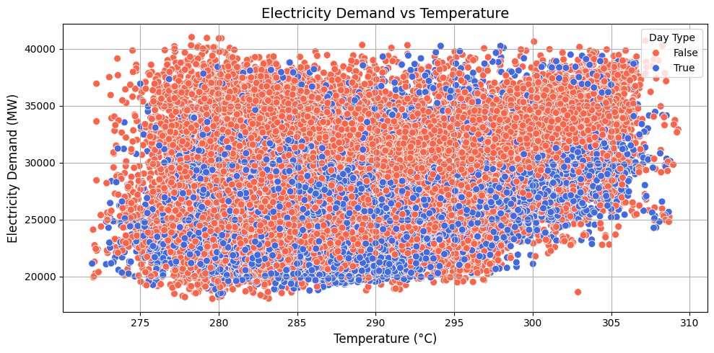
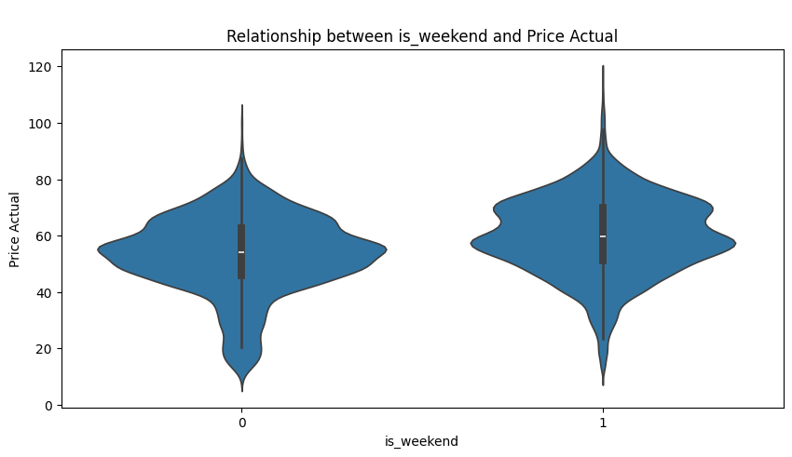
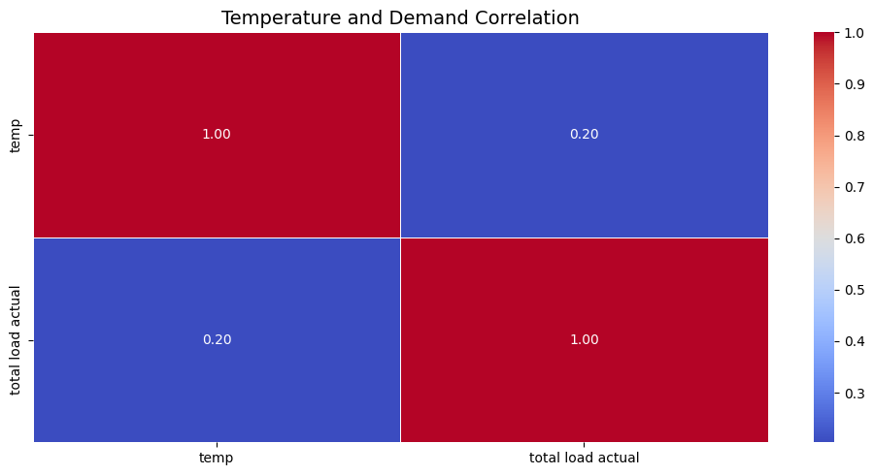

3. Visualization with Insights Contd…

Slide 12
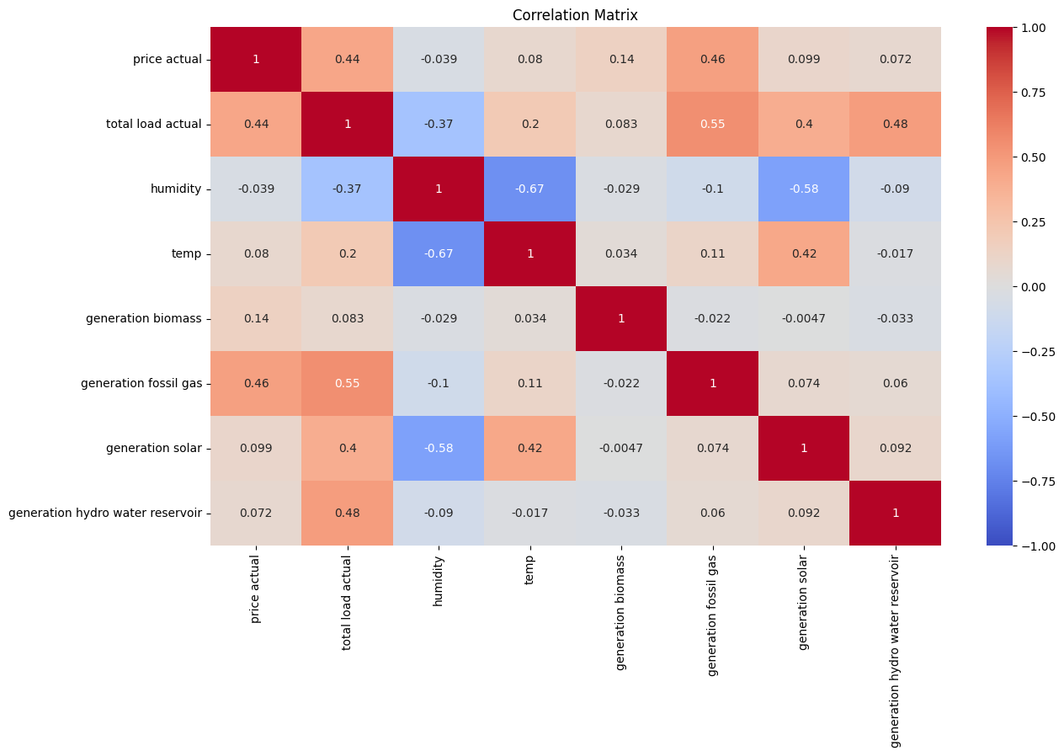
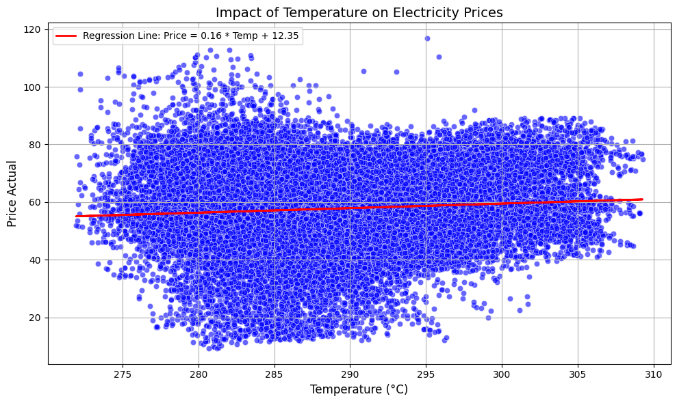
3. Visualization with Insights Contd…
Labeled Regression Line Plot: This scatter plot shows a positive correlation between temperature and electricity prices. Warmer weather likely means higher electricity demand for cooling, pushing prices up.
Price and Demand Fluctuations: This plot shows daily and seasonal electricity demand and price changes, highlighting weather influences and their correlation.

Slide 13
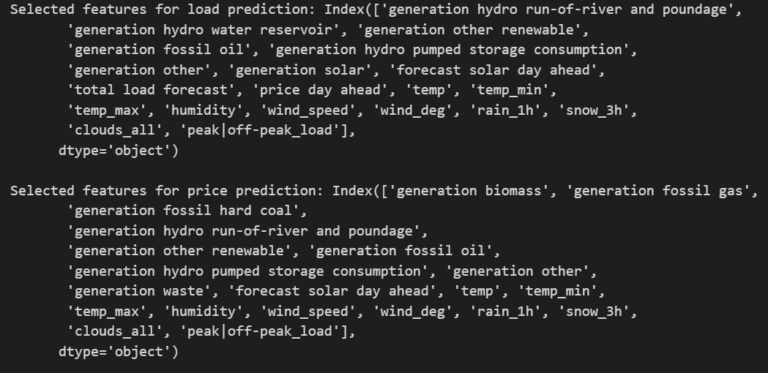
Feature Selection Using RFE (Recursive Feature Elimination)
RFE Method: Implemented Recursive Feature Elimination to select important features.
Features Selected: Identified and retained the most significant features for the model.
Selected Features for Electricity Load and Price Prediction:
These features were split into training and testing sets for further model development and evaluation.

Slide 14

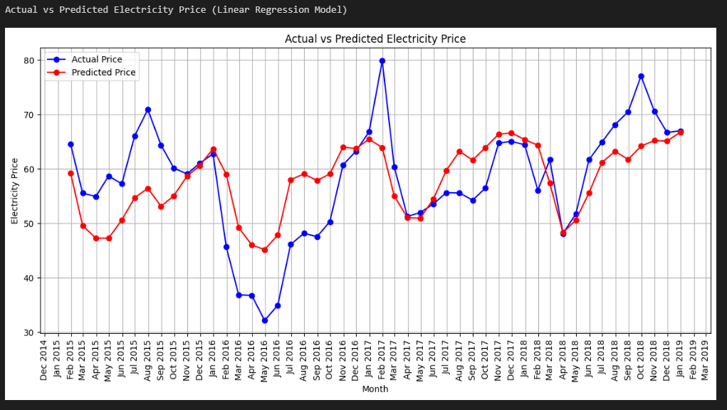
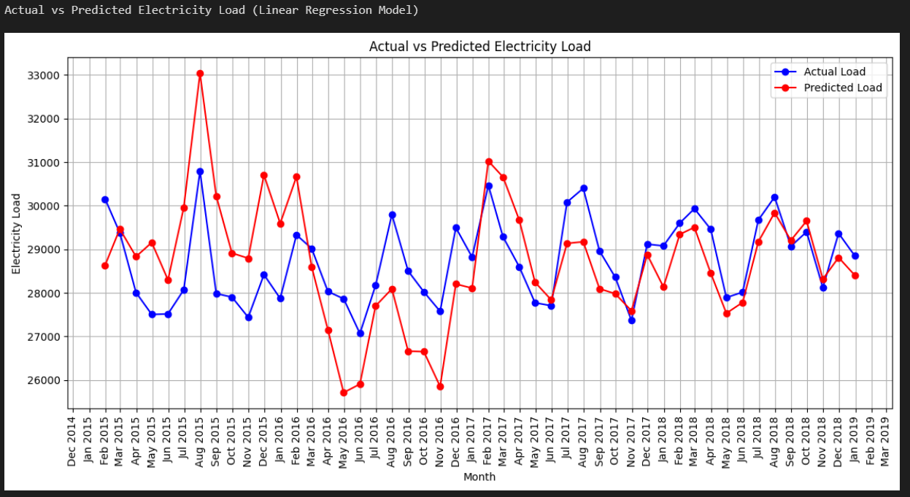
Machine Learning Models Implementation
1. Linear Regression Model
Linear Regression for Load MAPE : 1.1%
MAE : 314.41
RMSE : 474.47
R2 : 0.99
Adjusted R2 : 0.99
Linear Regression for Price MAPE : 15.76%
MAE : 7.73
RMSE : 9.86
R2 : 0.53
Adjusted R2 : 0.53

Slide 15
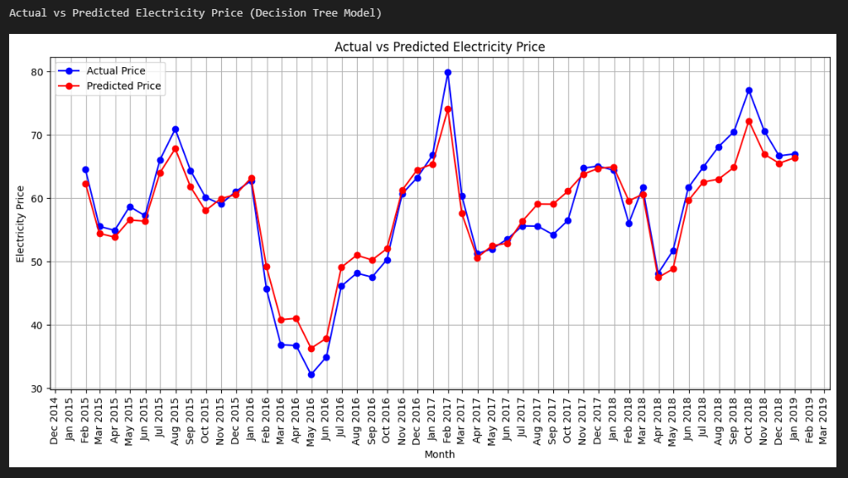
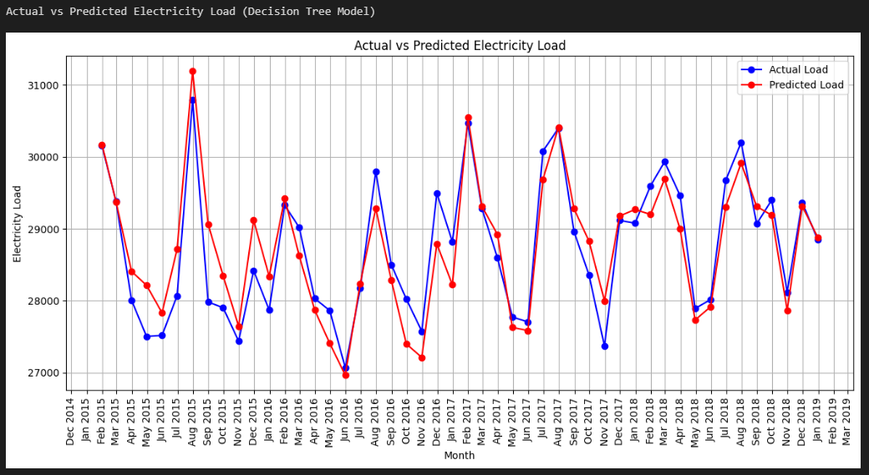
2. Decision Tree Model
Decision Tree for Load
MAPE : 1.45%
MAE : 417.4
RMSE : 606.89
R2 : 0.98
Adjusted R2 : 0.98
Decision Tree for Price MAPE : 9.26%
MAE : 4.68
RMSE : 7.42
R2 : 0.73
Adjusted R2 : 0.73

Slide 16
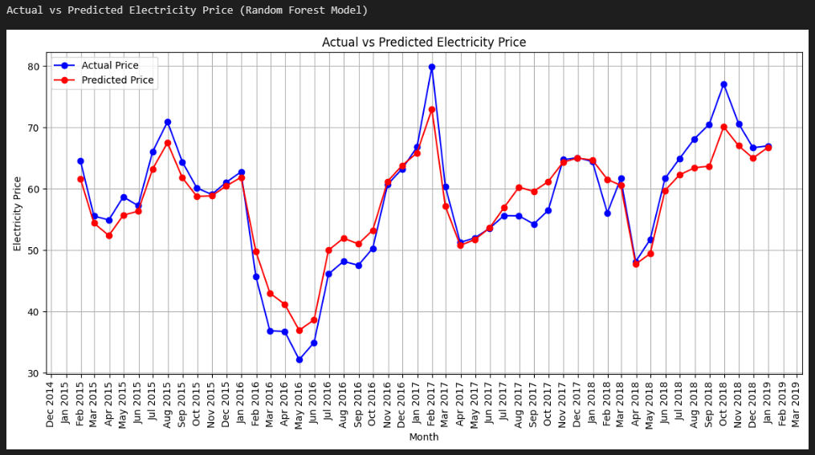

3. Random Forest Model
Random Forest for Load
MAPE : 1.07%
MAE : 305.21
RMSE : 455.86
R2 : 0.99
Adjusted R2 : 0.99
Random Forest for Price MAPE : 6.92%
MAE : 3.41
RMSE : 4.9
R2 : 0.88
Adjusted R2 : 0.88

Slide 17
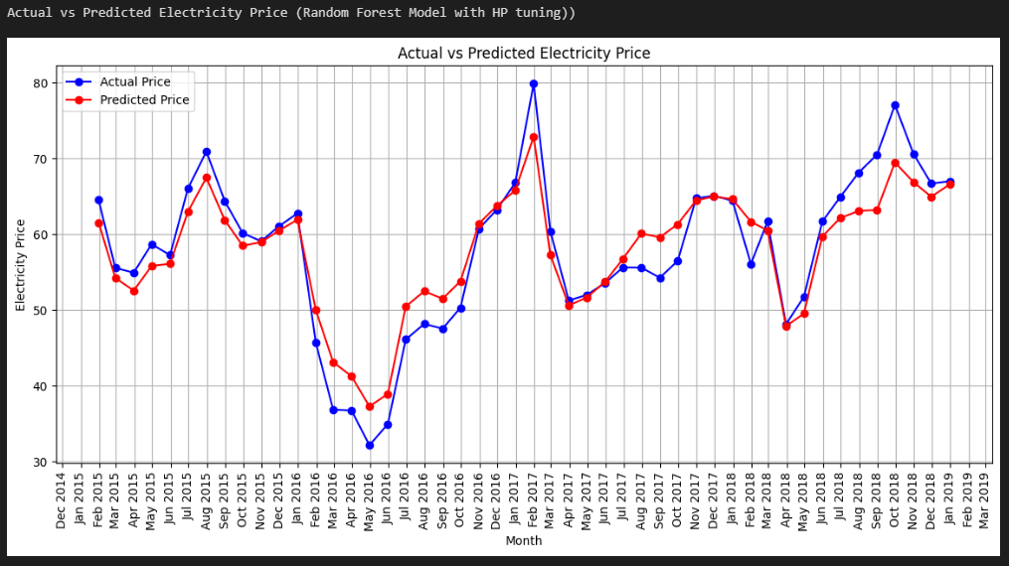
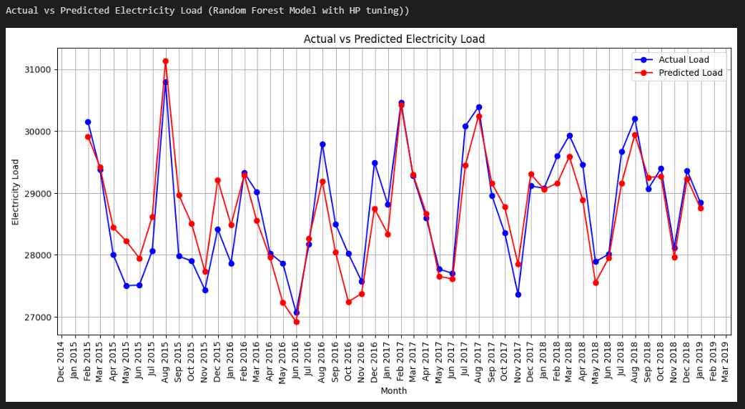
4. Random Forest Model with HP Tuning
Random Forest (Tuned) for Load
MAPE: 1.05
MAE: 299.79
RMSE: 454.39
R2: 0.99
Adjusted R2: 0.99
Random Forest (Tuned) for Price
MAPE : 11.06%
MAE : 5.53
RMSE : 7.45
R2 : 0.73
Adjusted R2 : 0.86

Slide 18
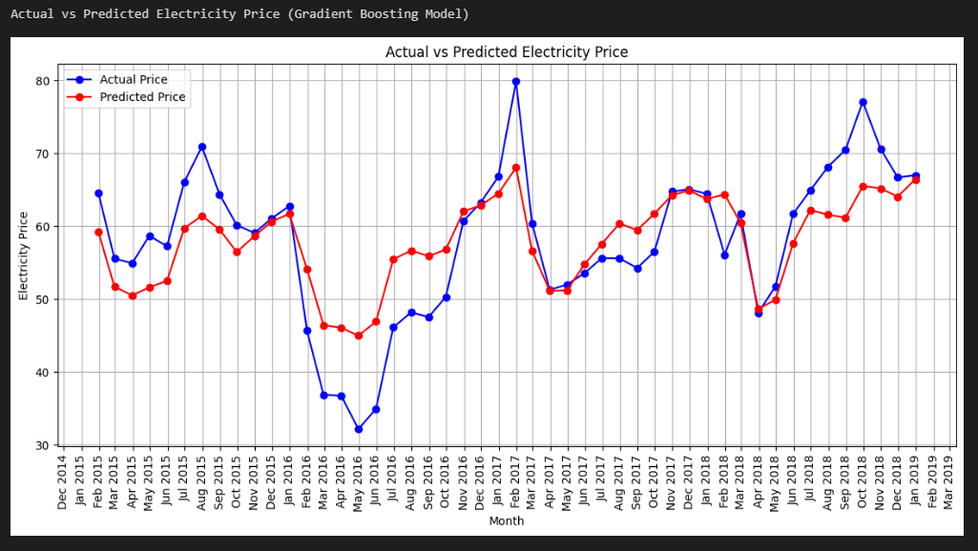
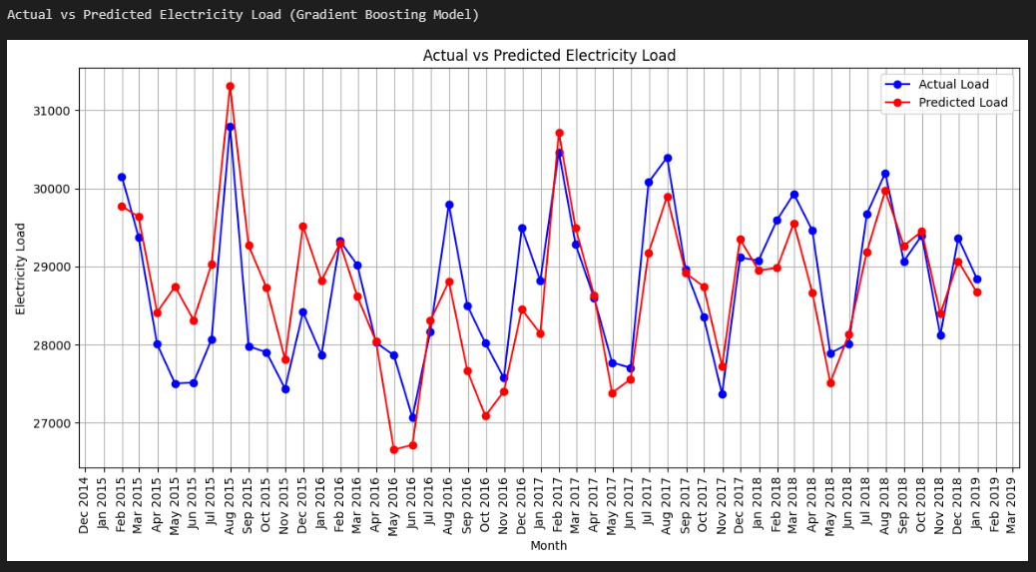
5. Gradient Boosting Model
Gradient Boosting for Load
MAPE : 1.06%
MAE : 304.01
RMSE : 455.8
R2 : 0.99
Adjusted R2 : 0.99
Gradient Boosting for Price MAPE : 12.36%
MAE : 4.37
RMSE : 7.93
R2 : 0.7
Adjusted R2 : 0.7

Slide 19
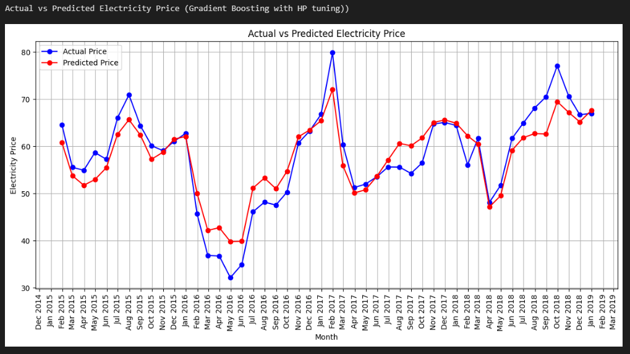
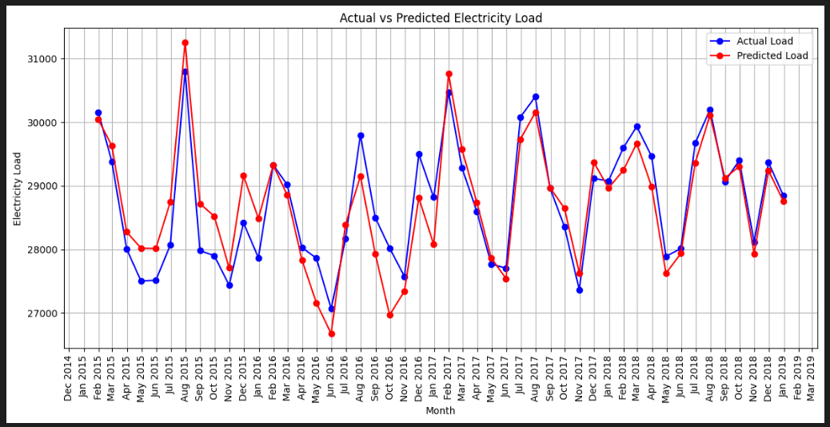
6. Gradient Boosting Model with HP Tuning
Gradient Boosting (Tuned) for Load MAPE : 1.28%
MAE : 350.74
RMSE : 500.2
R2 : 0.99
Adjusted R2 : 0.99
Gradient Boosting (Tuned) for Price
MAPE : 7.76%
MAE : 0.86
RMSE : 5.27
R2 : 0.87
Adjusted R2 : 0.87

Slide 20
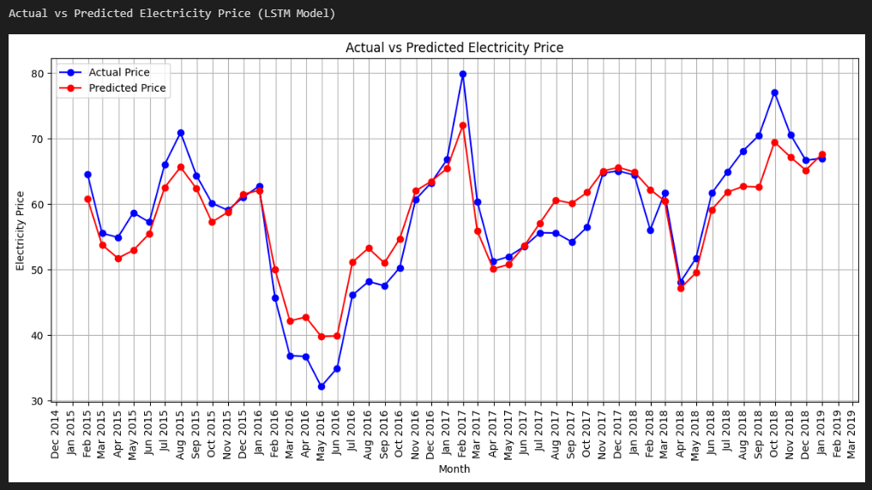
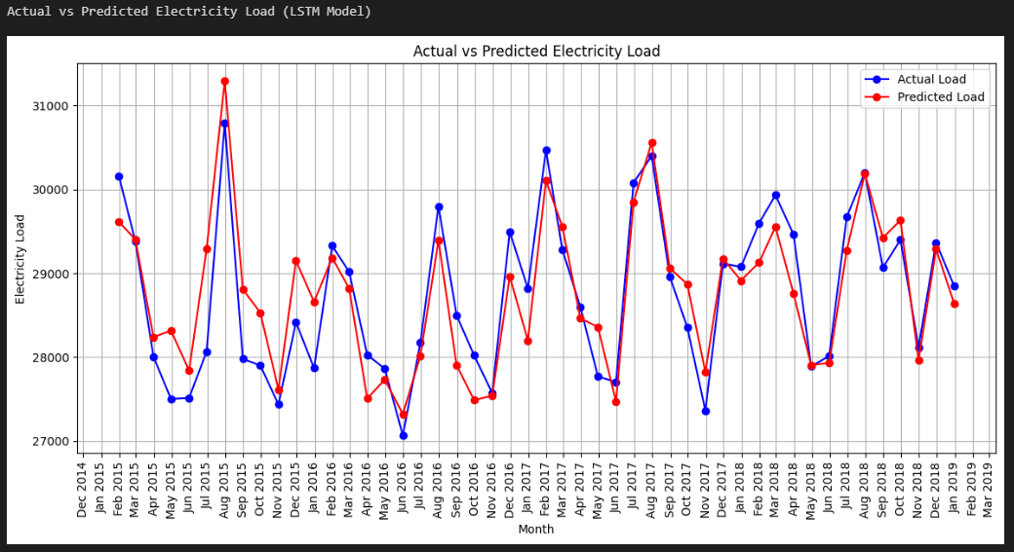
7. Long Short-Term Memory (LSTM) Model
LSTM for Load
MAPE : 0.99%
MAE : 279
RMSE : 411.18
R2 : 0.99
Adjusted R2 : 0.99
LSTM for Price
MAPE : 5.74%
MAE : 2.95
RMSE : 3.96
R2 : 0.92
Adjusted R2 : 0.92

Slide 21
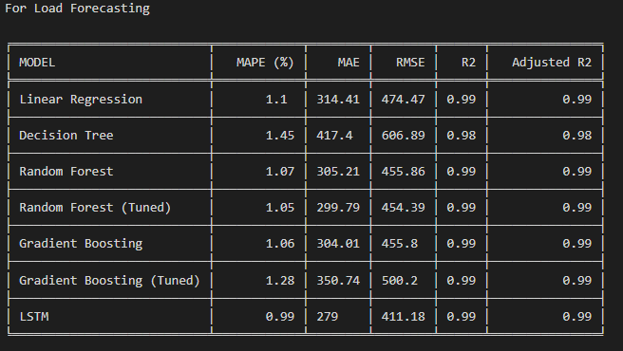
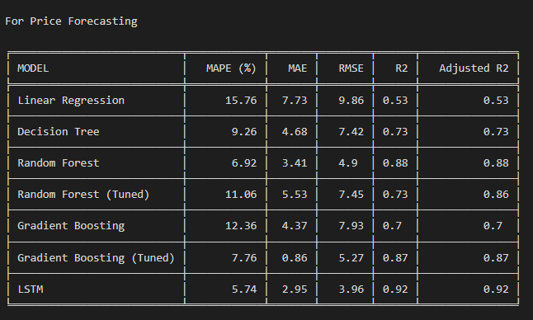
Model Comparison and Selection
Model Performance Metrics Table:
Compared models using metrics like MAPE, MAE, RMSE, R2, and Adjusted R2 to identify the best performer.
Selected Model: LSTM for both Load and Price Forecasting
Reasons:
Superior performance in key metrics
Balanced accuracy and computational efficiency
Scalable for varying data sizes and complexities

Slide 22
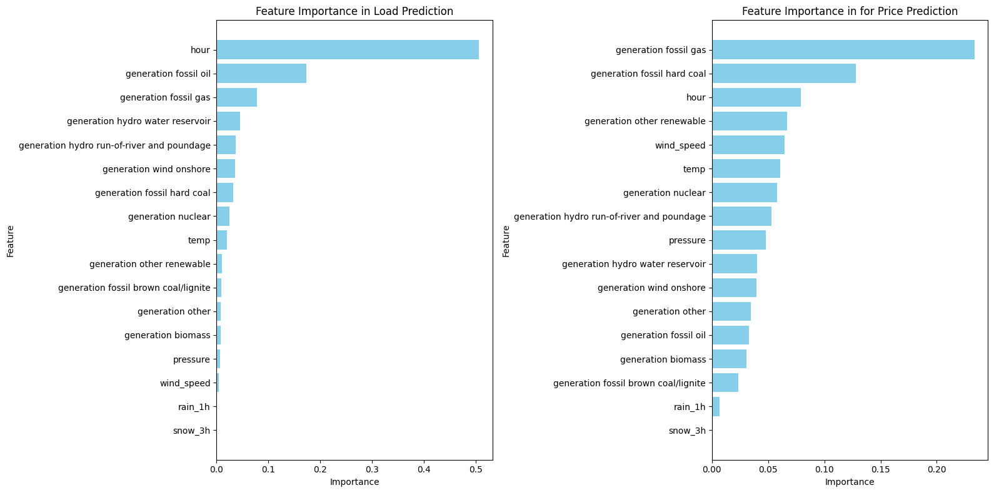
Importance of features for LSTM model in Load & Price Prediction
Feature Importance
Best Features for Load Forecasting:
Load: total load actual, peak/off-peak load
Generation: hydro storage, fossil fuels, biomass, renewables, nuclear
Price: forecast solar day ahead, avg_hourly_price, price actual
Weather: temp, wind, humidity, pressure
Temporal: hour, is_weekend, season
Best Features for Price Forecasting:
Price and Load: price_actual_interpolated, total load, avg_hourly_demand
Generation: fossil fuels, biomass, renewables, waste
Temporal: hour, is_weekend, Thursday, peak/off-peak, season
Monthly: March, December, November, October
Weather: temp, pressure

Slide 23
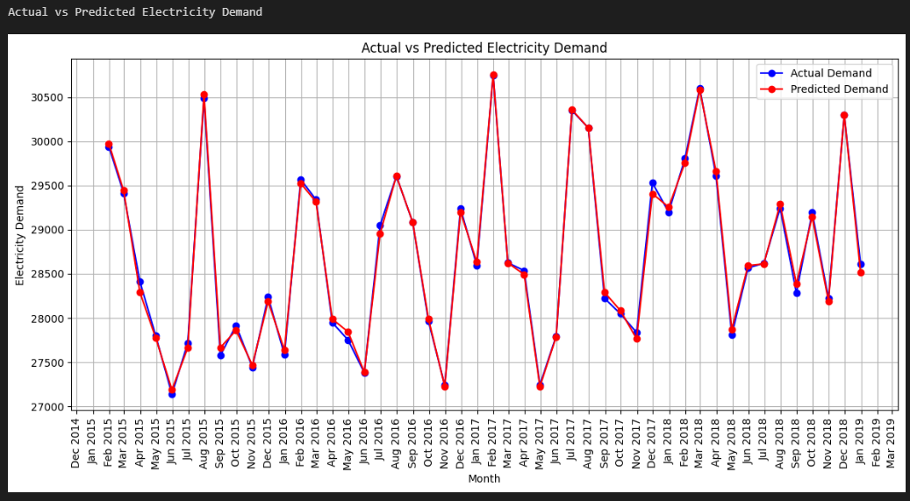
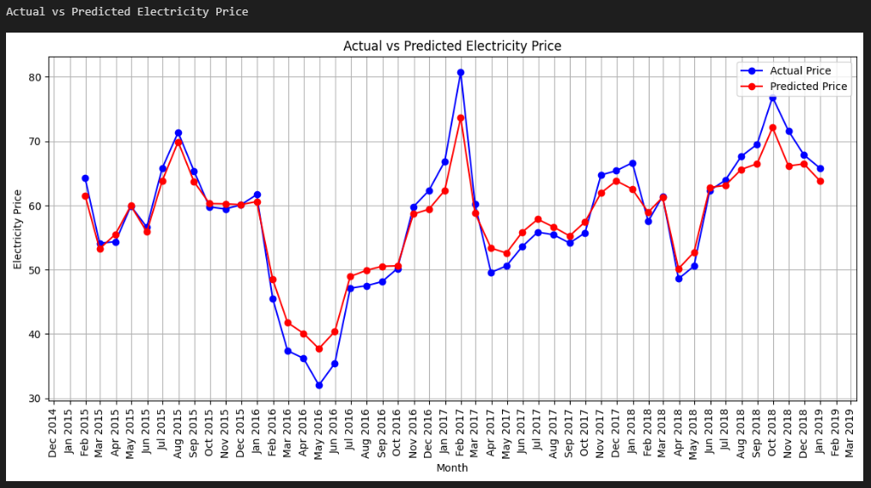
Conclusion
Higher demand in winter (Nov-Mar) and summer (Jun-Aug) due to heating and cooling needs.
Transition months (Apr, May, Sep, Oct) show stable, lower demand.
LSTM model performs best for demand predictions.
Prices rise during peak demand periods (winter and summer).
Strong correlation between temperature and electricity prices.
LSTM model provides accurate price predictions.
Electricity demand and prices are influenced by seasonal and weather factors.
LSTM models are effective for accurate forecasting, aiding in optimizing grid operations and decision-making.
Further model refinement and exploration of additional variables are recommended.

Slide 24


